Slide 1
Time Management

Slide 2
At this talk you will learn to:
Clarify your goals and achieve them
Handle people and projects that waste your time
Be involved in better delegation
Work more efficiently with your boss/advisor
Learn specific skills and tools to save you time
Overcome stress and procrastination
= really important point

Slide 3
Remember that time is money
Ben Franklin, 1748
Advice to a young tradesman

Slide 4
Introduction
Time must be explicitly managed, just like money
Much of this won’t make sense until later (too late?)

Slide 5
Outline
Why is Time Management Important?
Goals, Priorities, and Planning
TO DO Lists
Desks, paperwork, telephones
Scheduling Yourself
Delegation
Meetings
Technology
General Advice

Slide 6
Why Time Management is Important
“The Time Famine”
Bad time management = stress
This is life advice

Slide 7
The Problem is Severe
By some estimates, people waste about 2 hours per day. Signs of time wasting:
Messy desk and cluttered (or no) files
Can’t find things
Miss appointments, need to reschedule them late and/or unprepared for meetings
Volunteer to do things other people should do
Tired/unable to concentrate

Slide 8
Hear me Now, Believe me Later
Being successful doesn’t make you manage your time well.
Managing your time well makes you successful.

Slide 9
Goals, Priorities, and Planning
Why am I doing this?
What is the goal?
Why will I succeed?
What happens if I chose not to do it?

Slide 10
The 80/20 Rule
Critical few and the trivial many
Having the courage of your convictions
Good judgment comes from experience
Experiences comes from bad judgment

Slide 11
Inspiration
“If you can dream it, you can do it”
Walt Disney
Disneyland was built in 366 days, from ground-breaking to first day open to the public.

Slide 12
Planning
Failing to plan is planning to fail
Plan Each Day, Each Week, Each Semester
You can always change your plan, but only once you have one!

Slide 13
TO Do Lists
Break things down into small steps
Like a child cleaning his/her room
Do the ugliest thing first

Slide 14
The four-quadrant TO DO List
Due Soon
Not Due Soon
1 | 2
3 | 4
Important
Not
Important

Slide 15
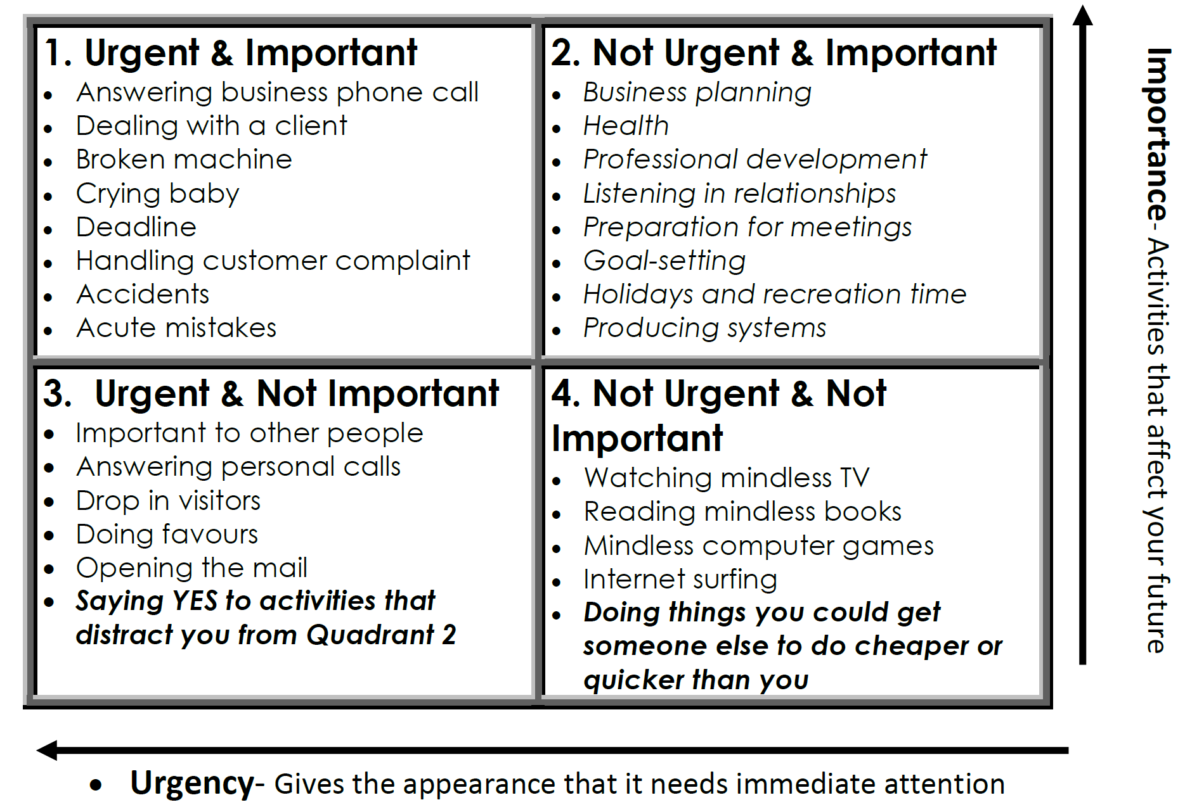

Slide 16
Paperwork
Clutter is death; it leads to thrashing. Keep desk clear: focus on one thing at a time
A good file system is essential
Touch each piece of paper once
Touch each piece of email once; your inbox is not your TODO list

Slide 17
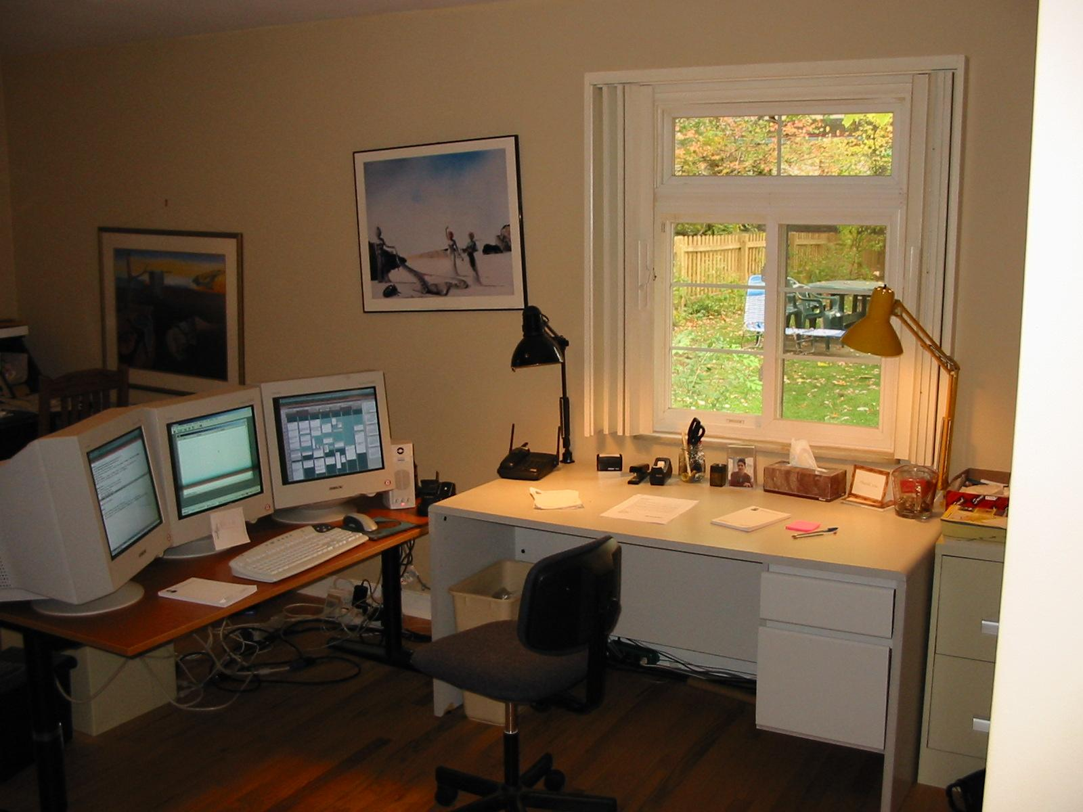
My Desk

Slide 18
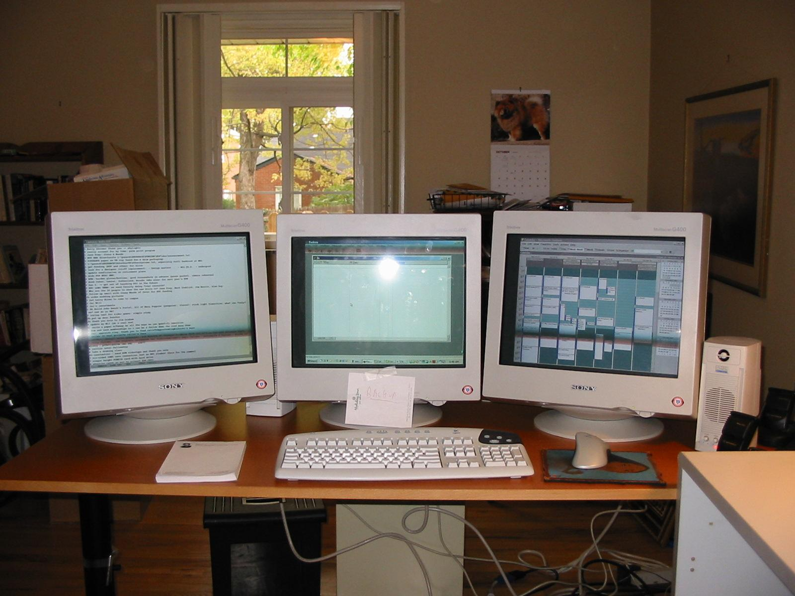

Slide 19
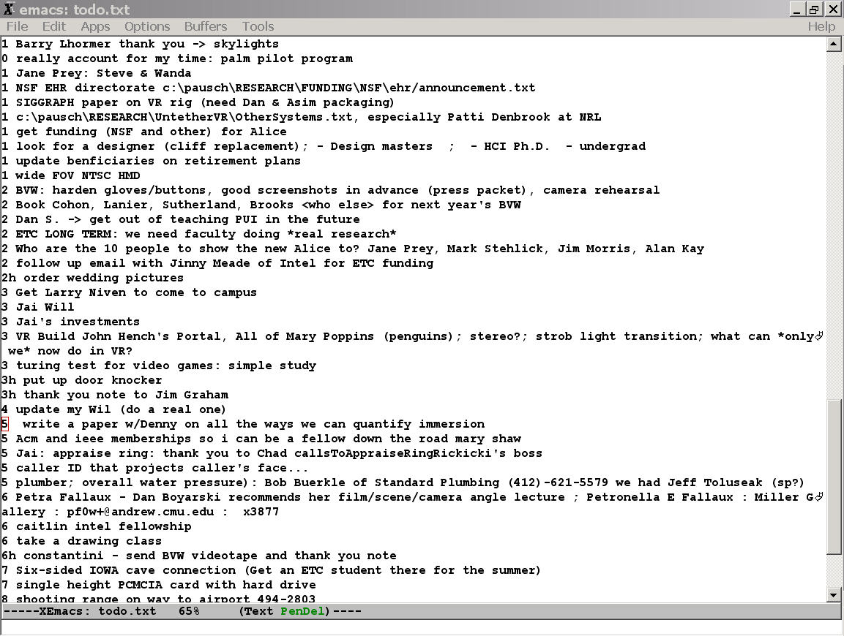

Slide 20
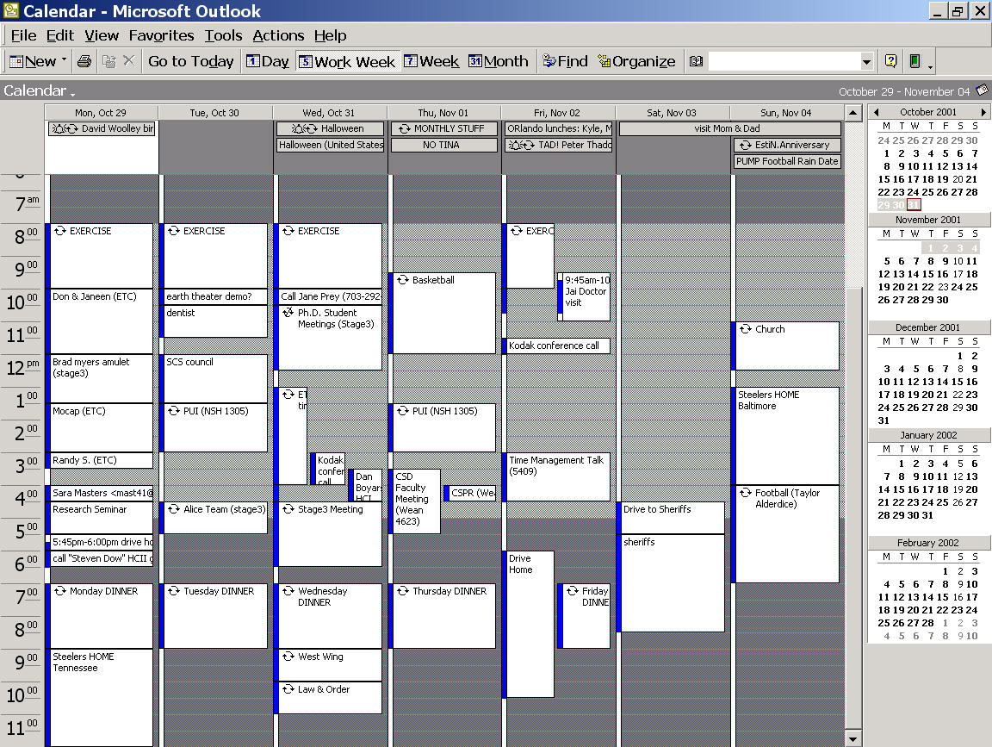

Slide 22
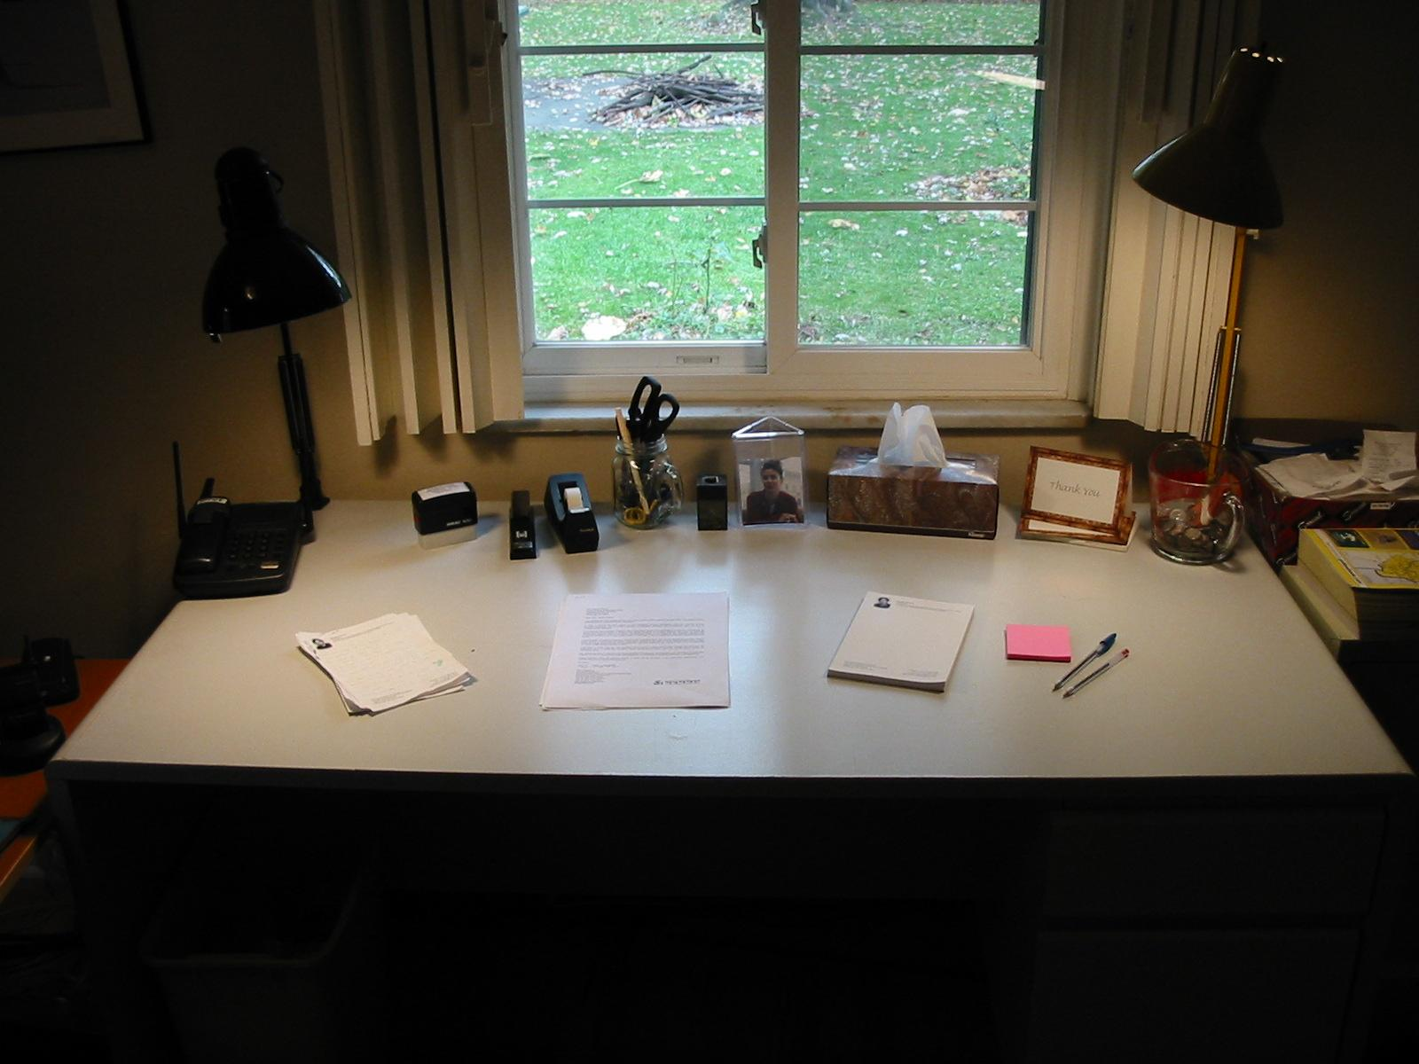

Slide 23
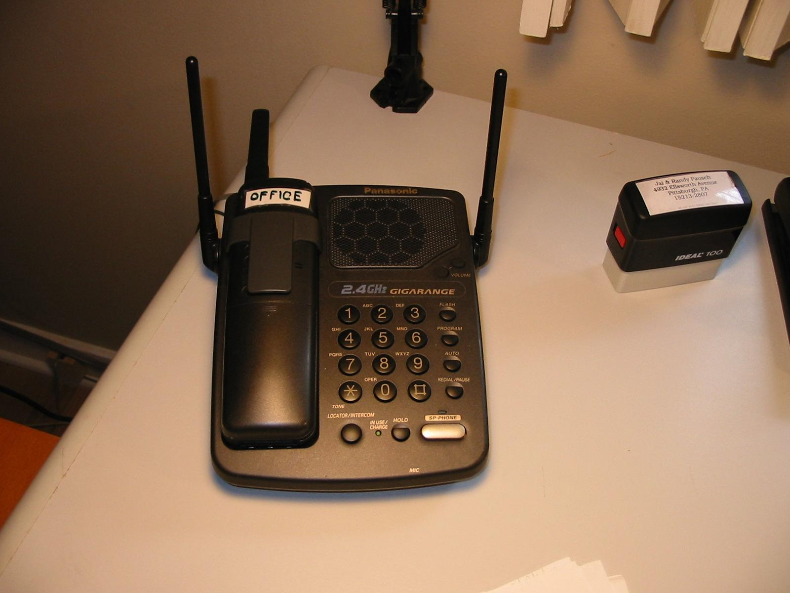
Speaker phone: hands are free to do something else; stress reduction when I’m on hold.

Slide 24
Telephone
Keep calls short; stand during call
Start by announcing goals for the call
Have something in view that you’re waiting to get to next

Slide 25
Telephone
When done, get off: “I have students waiting”
If necessary, hang up while you’re talking
Group outgoing calls: just before lunch and 5pm

Slide 26
Reading Pile
Only read something if you’ll be fired for not reading it

Slide 27
Office Logistics
Make your office comfortable for you, and optionally comfortable for others
No soft comfortable chairs! I have folding chairs, some people cut off front legs

Slide 28
Scheduling Yourself
You don’t find time for important things, you make it
Everything you do is an opportunity cost
Learn to say “No”

Slide 29
Learn to say “No”
Will this help me get tenure?
Will this help me get my masters?
Will this help me get my Ph.D?
Keep “help me” broadly defined

Slide 30
Gentle No’s
“I’ll do it if nobody else steps forward” or “I’ll be your deep fall back,” but you have to keep searching.
Moving parties in grad school…

Slide 31
Everyone has Good and Bad Times
Find your creative/thinking time. Defend it ruthlessly, spend it alone, maybe at home.
Find your dead time. Schedule meetings, phone calls, and mundane stuff during it.

Slide 32
Interruptions
6-9 minutes, 4-5 minute recovery – five interruptions shoots an hour
You must reduce frequency and length of interruptions (turn phone calls into email)
E-mail noise on new mail is an interruption -> TURN IT OFF!!

Slide 33
Cutting Things Short
“I’m in the middle of something now…”
Start with “I only have 5 minutes” – you can always extend this
Stand up, stroll to the door, complement, thank, shake hands
Clock-watching; on wall behind them

Slide 34
Time Journals
It’s amazing what you learn!
Monitor yourself in 15 minute increments for between 3 days and two weeks.

Slide 35
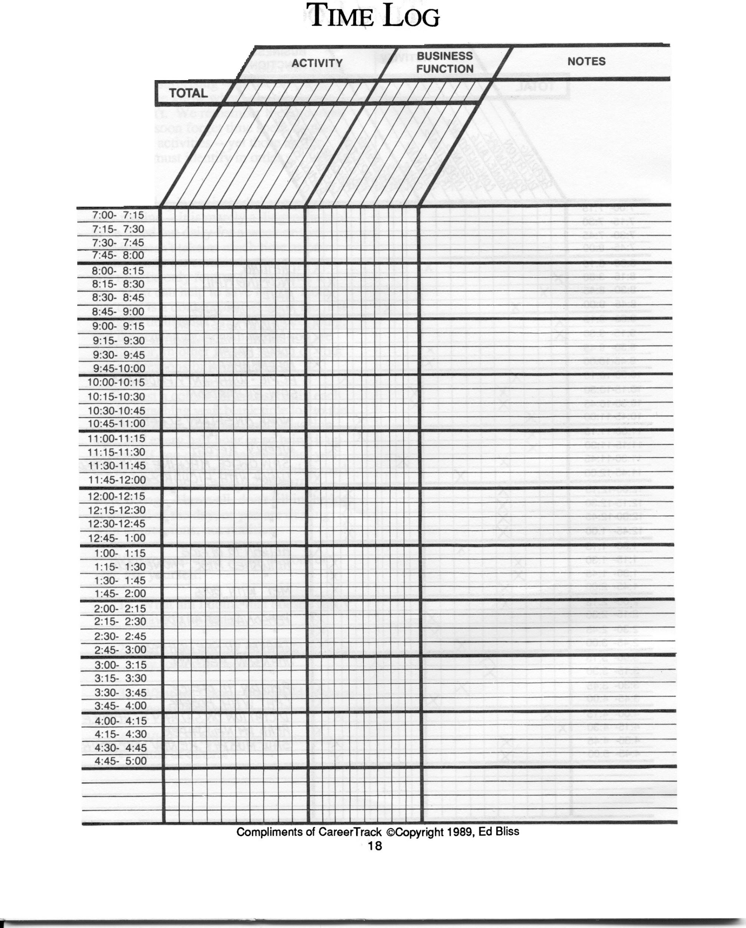

Slide 36
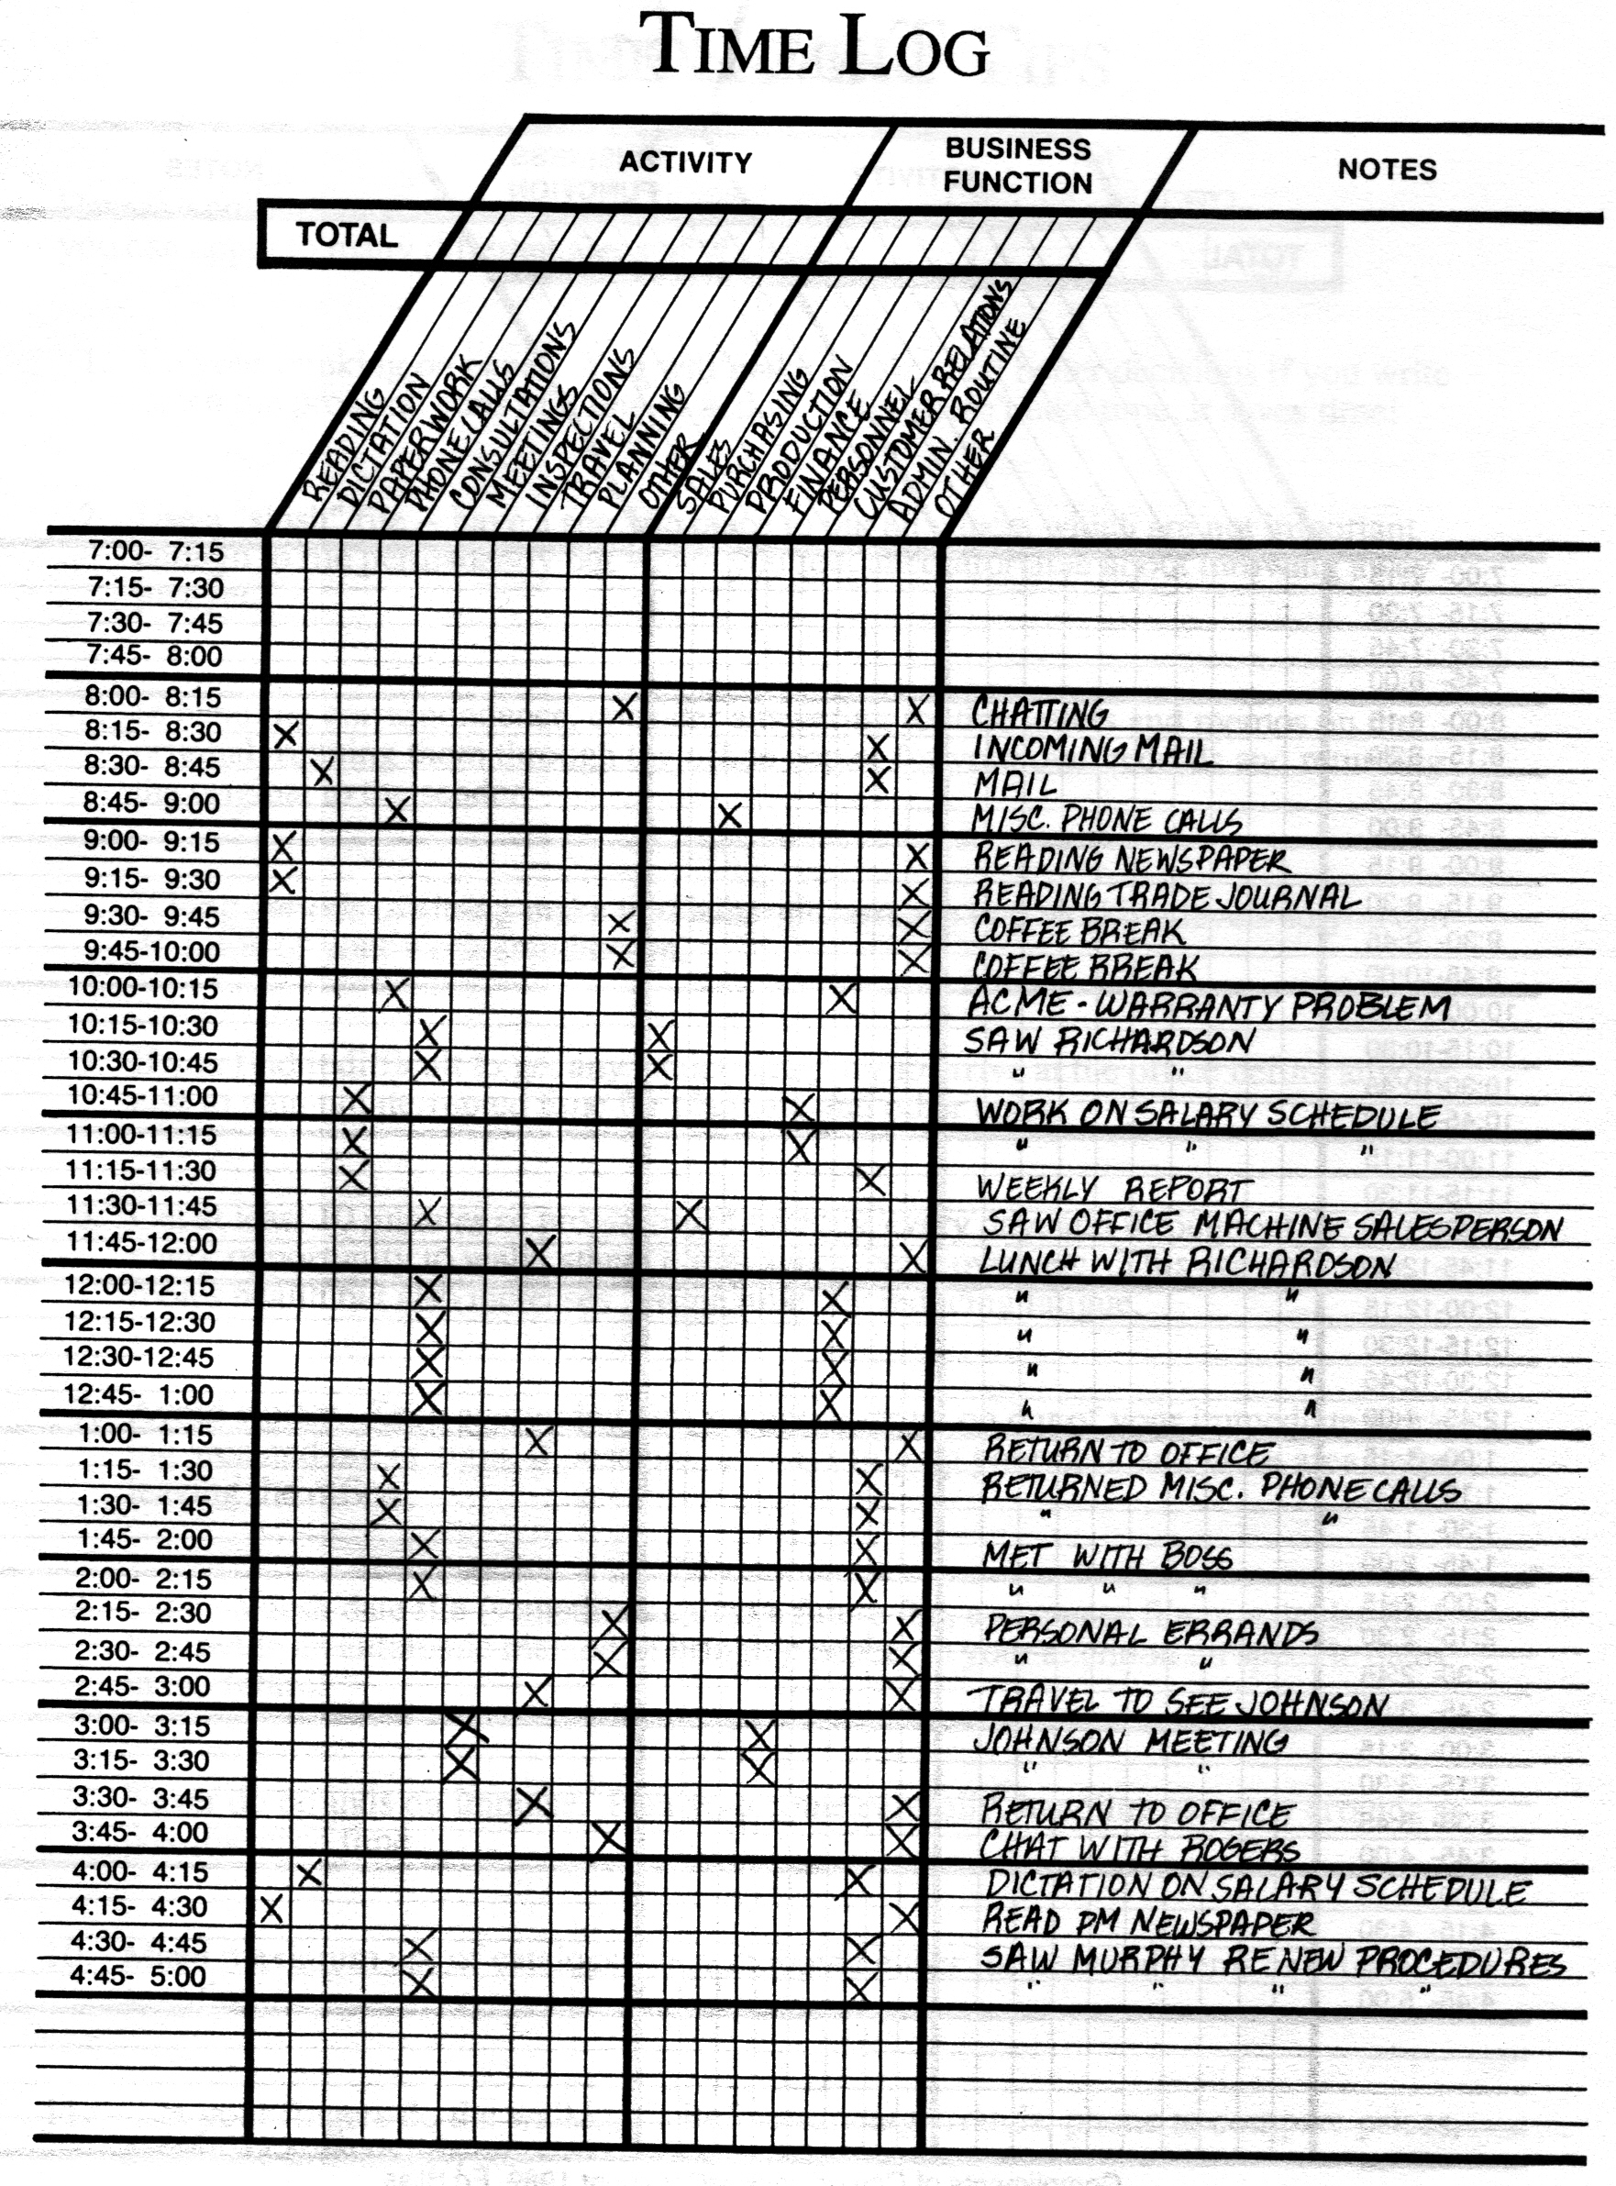

Slide 37
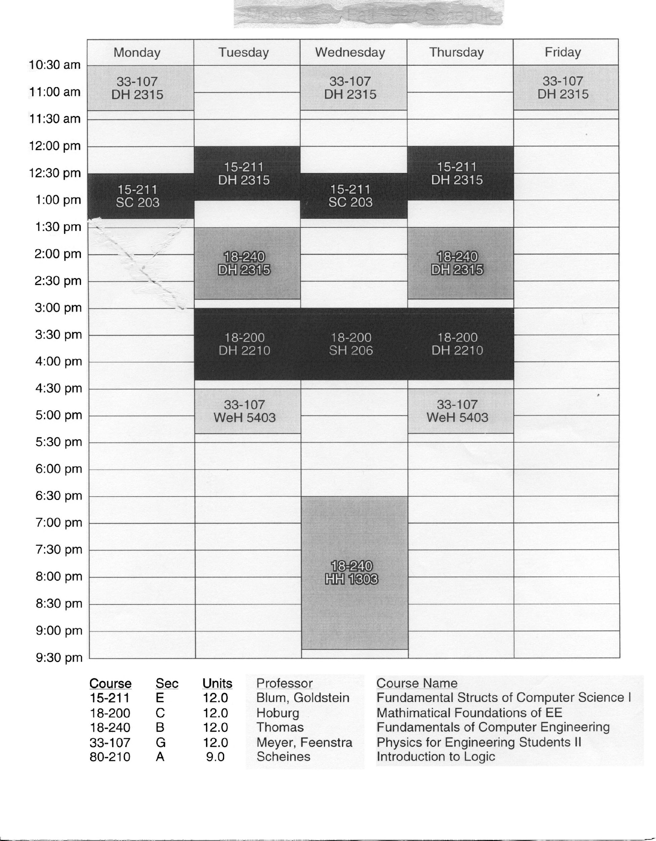

Slide 39
Using Time Journal Data
What am I doing that doesn’t really need to be done?
What am I doing that could be done by someone else?
What am I doing that could be done more efficiently?

Slide 40
Procrastination
“Procrastination is the thief of time”
Edward Young
Night Thoughts, 1742

Slide 41
Avoiding Procrastination
Doing things at the last minute is much more expensive than just before the last minute
Deadlines are really important: establish them yourself!

Slide 42
Comfort Zones
Identify why you aren’t enthusiastic
Fear of embarrassment
Fear of failure?
Get a spine!

Slide 43
Delegation
No one is an island
You can accomplish a lot more with help
Most delegation in your life is from faculty to graduate student

Slide 44
Delegation is not dumping
Grant authority with responsibility.
Concrete goal, deadline, and consequences.
Treat your people well

Slide 45
Challenge People
People rise to the challenge: You should delegate “until they complain”
Communication Must Be Clear: “Get it in writing” – Judge Wapner
Give objectives, not procedures
Tell the relative importance of this task

Slide 46
Sociology
Beware upward delegation!
Ignorance is your friend – I do not know how to run the photocopier or the fax machine

Slide 47
Meetings
Average executive: > 40% of time
Lock the door, unplug the phone
Maximum of 1 hour
Prepare: there must be an agenda
1 minute minutes: an efficient way to keep track of decisions made in a meeting: who is responsible for what by when?

Slide 48
Technology
Laptop computer (and docking station)
one machine in your life is the right number
ACM Digital Library (I haven’t been in the library in over five years)

Slide 49
Randy’s Magic E-Mail Tips
Save all of it; no exceptions
If you want somebody to do something, make them the only recipient. Otherwise, you have diffusion of responsibility. Give a concrete request/task and a deadline.
If you really want somebody to do something, CC someone powerful.
Nagging is okay; if someone doesn’t respond in 48 hours, they’ll probably never respond. (True for phone as well as email).

Slide 50
Care and Feeding of Advisors
Time Management Advice
Get a day timer or PDA
Write things down
When’s our next meeting?
What’s my goal to have done by then?
Who to turn to for help?
Remember: advisors want results !

Slide 51
General Advice: Vacations
Phone callers should get two options:
If this can’t wait, contact John Smith at 555-1212
Otherwise please call back June 1
This works for Email too!
Vacations should be vacations.
It’s not a vacation if you’re reading email

Slide 52
General Advice
Kill your television (how badly do you want tenure or your degree?)
Turn money into time – especially important for people with kids or other family commitments
Eat and sleep and exercise. Above all else!

Slide 53
General Advice
Never break a promise, but re-negotiate them if need be.
Recognize that most things are pass/fail.

Slide 54
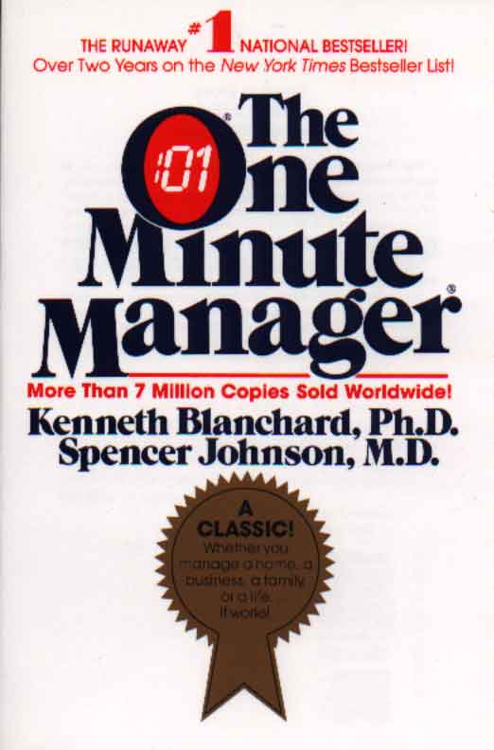
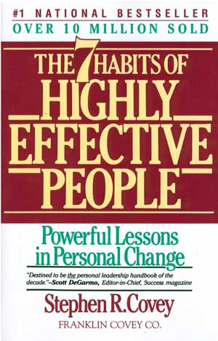
Recommended Readings
The One Minute Manager, Kenneth Blanchard and Spencer Johnson, Berkeley Books, 1981, ISBN 0-425-09847-8
The Seven Habits of Highly Effective People, Stephen Covey, Simon & Schuster, 1989, ISBN 0-671-70863-5

Slide 55
Action Items
Get a day-timer (or PDA) if you don’t already have one
Start keeping your TODO list in four-quadrant form or ordered by priorities (not due dates)
Do a time journal, or at least record number of hours of television/week
Make a note in your day-timer to revisit this talk in 30 days (www.randypausch.com). At that time, ask yourself “What behaviors have I changed?”

Slide 56
Time Management
Randy Pausch
Carnegie Mellon University
http://www.randypausch.com

Slide 57
Appendix:
Stephen Covey’s “Seven Habits”
Advice I have for working in groups.

Slide 58
The Seven Habits
BE PROACTIVE: Between stimulus and response in human beings lies the power to choose. Productivity, then, means that we are solely responsible for what happens in our lives. No fair blaming anyone or anything else.
BEGIN WITH THE END IN MIND: Imagine your funeral and listen to what you would like the eulogist to say about you. This should reveal exactly what matters most to you in your life. Use this frame of reference to make all your day-to-day decisions so that you are working toward your most meaningful life goals.

Slide 59
The Seven Habits
From “The Seven Habits of Highly Effective People: Restoring the Character Ethic” by Stephen R. Covey, Simon and Schuster, 1989
PUT FIRST THINGS FIRST. To manage our lives effectively, we must keep our mission in mind, understand what’s important as well as urgent, and maintain a balance between what we produce each day and our ability to produce in the future.
THINK WIN/WIN. Agreements or solutions among people can be mutually beneficial if all parties cooperate and begin with a belief in the “third alternative”: a better way that hasn’t been thought of yet.

Slide 60
The Seven Habits
From “The Seven Habits of Highly Effective People: Restoring the Character Ethic” by Stephen R. Covey, Simon and Schuster, 1989
SEEK FIRST OT BE UNDERSTANDING, THEN TO BE UNDERSTOOD. Most people don’t listen. Not really. You’ll be more effective in you relationships with people if you sincerely try to understand them fully before you try to make them understand your point of view

Slide 61
Seven Habits
From “The Seven Habits of Highly Effective People: Restoring the Character Ethic” by Stephen R. Covey, Simon and Schuster, 1989
SYNERGIZE. Just what it sound like. The whole is greater than the sum of its parts. In practice, this means you must use “creative cooperation” in social interactions. Value differences because it is often the clash between them that leads to creative solutions.

Slide 62
Seven Habits
From “The Seven Habits of Highly Effective People: Restoring the Character Ethic” by Stephen R. Covey, Simon and Schuster, 1989
SHARPEN THE SAW. This is the habit of self-renewal, which has four elements.
The first is mental,
which includes reading, visualizing, planning and writing.
The second is spiritual,
which means\study and meditation.
Third is social/emotional, which stress management includes
service, empathy
Finally, the physical includes
exercise, nutrition and stress management.

Slide 63
Tips for Working in Groups
By Randy Pausch, for the Building Virtual Worlds course at Carnegie Mellon, Spring 1998
Meet people properly. It all starts with the introduction. Then, exchange contact information, and make sure you know how to pronounce everyone’s names. Exchange phone #s, and find out what hours are acceptable to call during.
Find things you have in common. You can almost always find something in common with another person, and starting from that baseline, it’s much easier to then address issues where you have difference.

Slide 64
Tips for Working in Groups
By Randy Pausch, for the Building Virtual Worlds course at Carnegie Mellon, Spring 1998
Make meeting conditions good. Have a large surface to write on, make sure the room is quiet and warm enough, and that there aren’t lots of distractions. Make sure no one is hungry, cold, or tired. Meet over a meal if you can; food softens a meeting.
Let everyone talk. Even if you think what they’re said is stupid. Cutting someone off is rude, and not worth whatever small time gain you might make. Don’t finish someone’s sentences for him or her; they can do that for themselves. And remember: talking louder or faster doesn’t make your idea any better.

Slide 65
Tips for Working in Groups
By Randy Pausch, for the Building Virtual Worlds course at Carnegie Mellon, Spring 1998
Check your egos at the door. When you discuss ideas, immediately label them and write them down. The labels should be descriptive of the idea, not the originator:
Praise each other. Find something nice to say, even if it’s a stretch. Even the worst of ideas has a silver lining inside it, if you just look hard enough. Focus on the good, praise it, and then raise any objections or concerns you have about the rest of it.

Slide 66
Tips for Working in Groups
By Randy Pausch, for the Building Virtual Worlds course at Carnegie Mellon, Spring 1998
Put if in writing. Always write down who is responsible for what, by when. Be concrete. Arrange meetings by email, and establish accountability.
Be open and honest. Talk with your group members if there’s a problem, and talk with me if you think you need help..

Slide 67
Tips for Working in Groups
By Randy Pausch, for the Building Virtual Worlds course at Carnegie Mellon, Spring 1998
Avoid conflict at all costs. When stress occurs and tempers flare, take a short break. Clear your heads, apologize, and take another stab at it. Apologize for upsetting your peers, even if you think someone else was primarily at fault; the goal is to work together, not start a legal battle over whose transgressions were worse. It takes two to have an argument, so be the peacemaker.
Phrase alternatives as questions. Instead of “I think we should do A, not B,” try “What if we did A, instead of B?” That allows people to offer comments, rather than defend one choice.

